Slide 1
Deep Reinforcement learning
Team-DRL
Anjaneyalu
Shiva Prasad

Slide 2
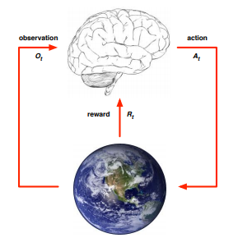
Introduction
Reinforcement learning seeks to create intelligent agents that adapt to environment by analysing their own experience.
Reinforcement learning is an important type of Machine Learning where an agent learns how to behave in an environment by performing actions and seeing the results

Slide 3
Buzz words in RL
Agent : Our Hero
Environment : Where agent lives and carryout its tasks
Action : outcome of Policy which leads to change of state
Reward : feed back from environment: numeric
Policy : tells which action to take
State : a numerical representation
Goal state : Final required state
Episode: list of States, Actions, Rewards, and New States

Slide 4
Demo 1 : Landing Rocket on moon
Objective:
Our agent should land at a specified landing pad in the environment.
Key points
Agent has enough fuel to fly in environment.
Agent is always beginning from the same point.
Environment is an obstacle free environment.
Agent has left orientation engine,right orientation engine,main engine

Slide 5
Demo 1 : Lunar Lander(Rocket Landing on moon)
State represents a pixel value on the screen
“Lunar Lander-v1” is the environment used from open AI’s gym library.
Agent can take actions do nothing, fire left orientation engine, fire right orientation engine, fire main engine.
Agent gets positive rewards if he lands close to the landing point and negative reward points if he lands far from the landing pad
Agent goal is to maximize the sum of reward points so that he reaches to the goal state.

Slide 6

When Agent is new to the Environment- trained -10 sessions

Slide 7
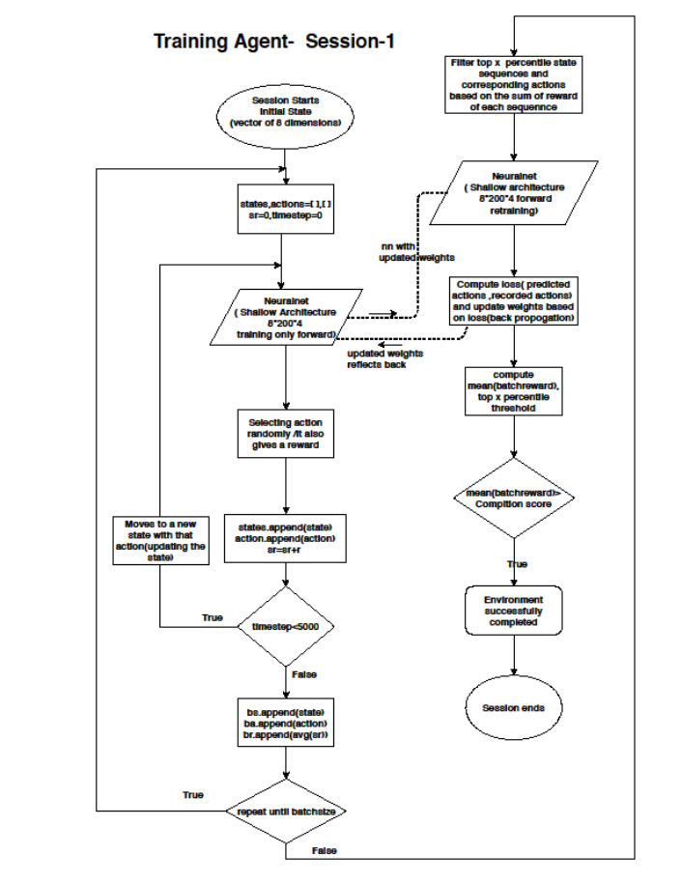

Flow Diagram-Agent training

Slide 8

When Agent is new to the Environment- trained -50 sessions

Slide 9

After 100 sessions…

Slide 10

After 150 sessions

Slide 11

After 200 sessions

Slide 12
Applications
Resources management in computer clusters
Traffic Light Control
Robotics
Web System Configuration
Personalized Recommendations.

Slide 13
References:
[1] Lapan, Maxim — Deep Reinforcement Learning Hands-On, Packt Publishing, 2018
[2] Sutton R. and Barto A. — Reinforcement Learning: An Introduction, MIT Press, 1998
[3] Playing Atari with Deep Reinforcement Learning. https://arxiv.org/pdf/1312.5602v1.pdf
[4] https://medium.com/coinmonks/landing-a-rocket-with-simple-reinforcement-learning-3a0265f8b58c
[5] https://allan.reyes.sh/projects/gt-rl-lunar-lander/
[6] H.Mao, Alizadeh, M. Alizadeh, Menache, I.Menache, and S.Kandula. Resource Management With deep Reinforcement Learning. In ACM Workshop on Hot Topics in Networks, 2016.
[7] I. Arel, C. Liu, T. Urbanik, and A. Kohls, “Reinforcement learning-basedmulti-agent system for network traffic signal control,”IET IntelligentTransport Systems, 2010.

